Slide 1
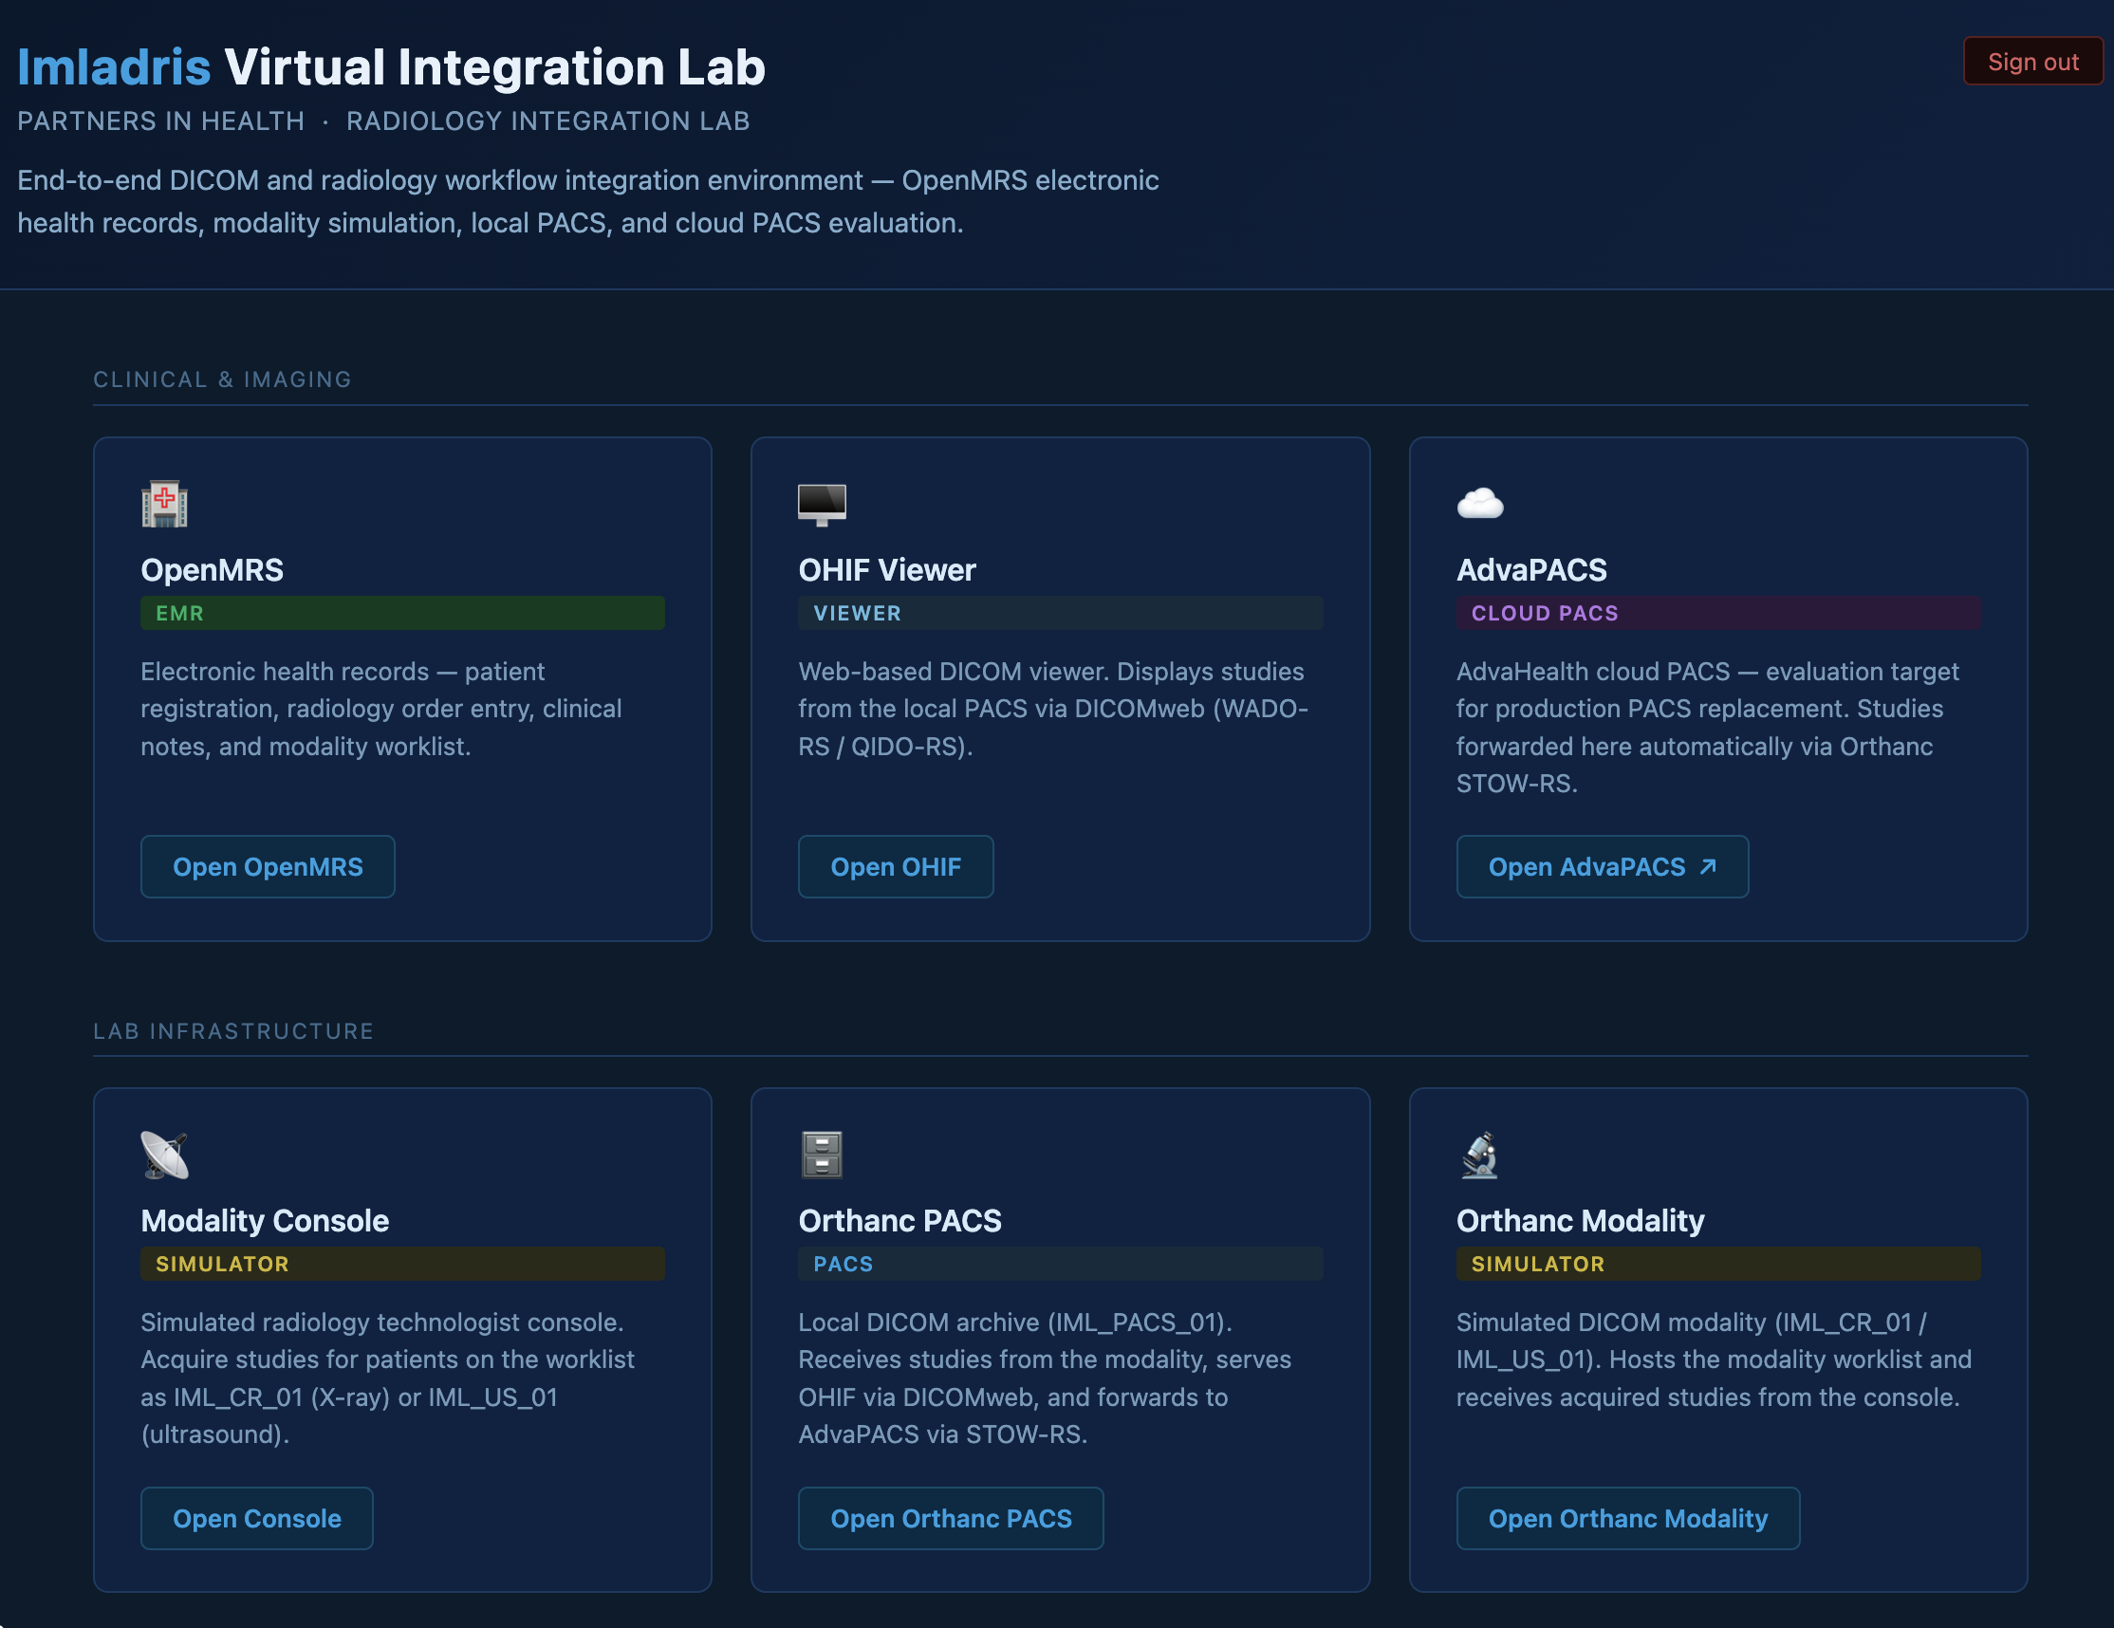
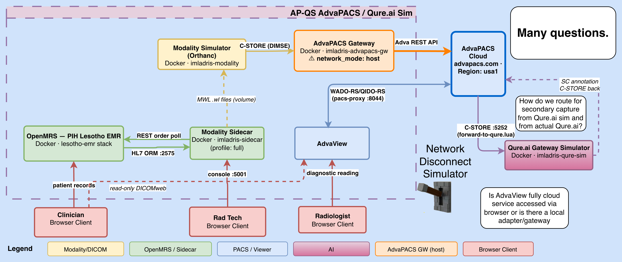
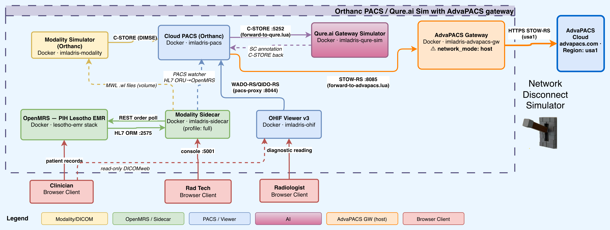
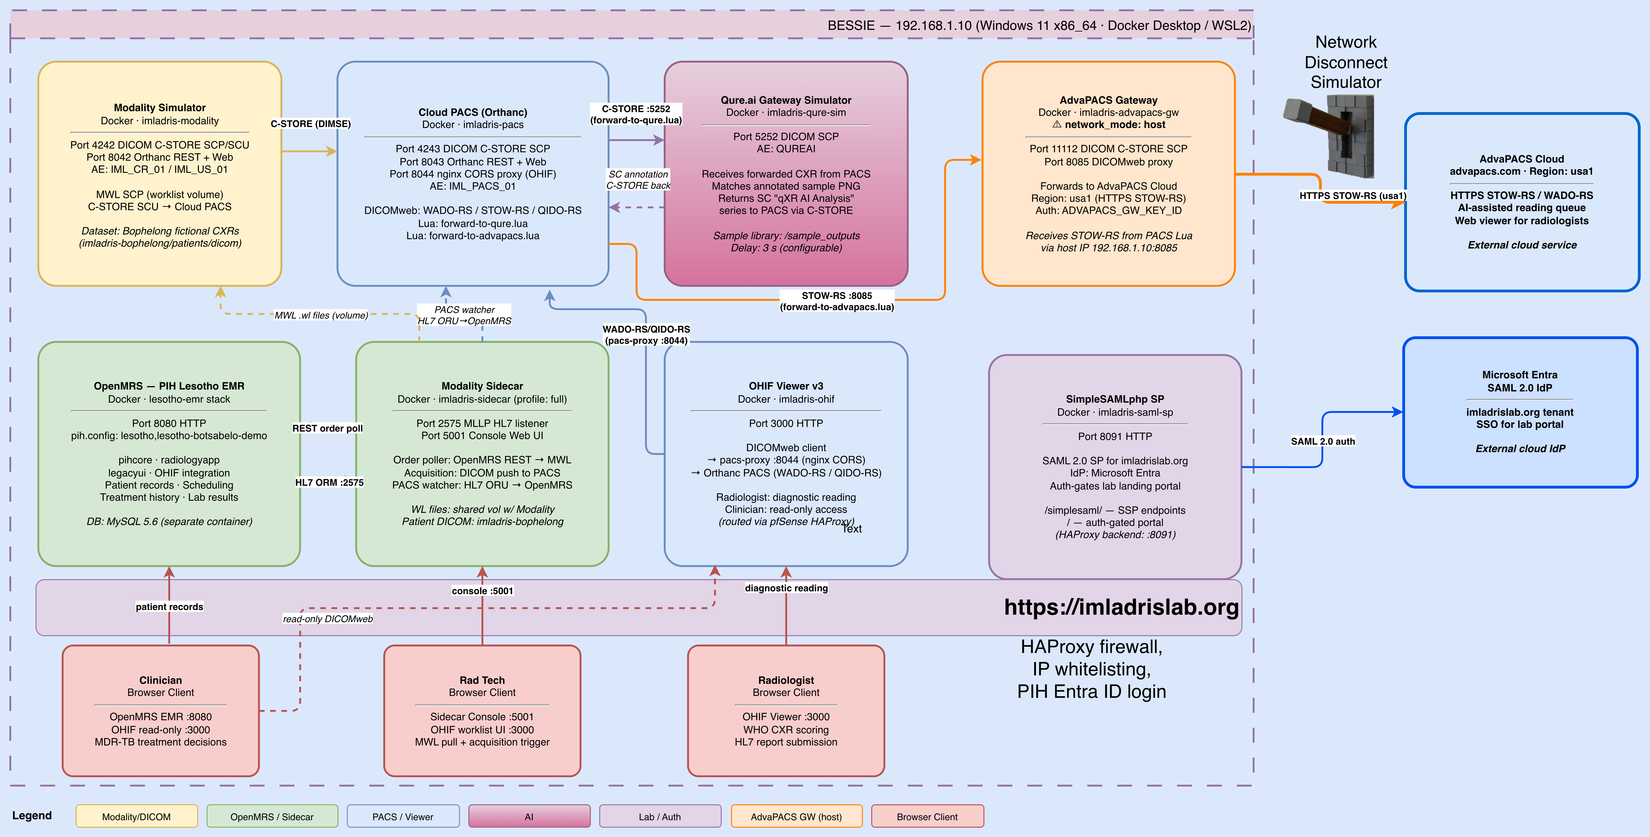
The Imladris Integration, Test, and Training Lab
Imaging Lab for Digital Radiography Information Systems (IMLADRIS)
July 6, 2026

Slide 2
The Imladris Integration, Test and Training Lab
Purpose: Accelerate a successful deployment of EMR and PACS to Botsabelo Hospital and its network of fixed and mobile clinics.
Integrate
Integrate components of the overall system to ensure they function correctly, learn the configuration and operation details.
Evaluate possible integrations with other existing or new components.
Test
Develop all key workflows and exercise them to make them understandable and robust for our Lesotho staff.
Be able to quickly reproduce issues with fictional working data to share with external support organizations.
Stage and test new releases of all software components.
Train
Set up hands-on training modules allowing staff to assume the roles of fictional staff to develop competency and confidence with the new EMR and PACS systems.
Use videos and screenshots from the lab to create on-demand, self-paced study modules.

Slide 3
Support Realistic Scenarios without PII/PHI
Only support configurations or scenarios that support real needs.
For example, don’t try to be realistic about operating modalities, no need to support radiologic technologists (radtechs), so lab has minimal modality console/simulator
Only support UI for identified workflows for Lesotho EMR + PACS operations.
Support a well-defined, verifiable process that satisfies regulatory requirements for anonymizing patient data to use in the lab.
Stress test the technology beyond what our users could expect. E.g. the “Network Disconnect Simulator”

Slide 4
Integrate Digital Radiology Information System elements.
What is integrated today?
OpenMRS – Lesotho-emr configuration
Modality simulators
Multiple PACS options with routing
AdvaPACS access via AdvaPACS Gateway
Simple routing to a Qure.ai simulator for secondary capture of Qure results.
What is possible tomorrow?
AdvaView viewer evaluation configurations.
Qure integration (replace the sim)
Alternate ‘sign in with’ connectors besides PIH Entra ID.

Slide 5
Test components/workflows in the Bophelong MDR-TB Hospital
Provide a complete, complex fictional set of staff, patients, medical histories and images to use to test new releases of software or to reproduce issues reported from the field.
First pass integration of the Lesotho-EMR OpenMRS found and addressed 5 issues affecting usability. Dev team engaged via PIHEMR Jira.
Developing initial end-to-end workflows for patient treatment.
Finding workflow steps that are unclear, incomplete, or exhibit bugs in underlying software.

Slide 6
Train staff for the Botsabelo MDR-TB Hospital
Provide a complete, complex fictional set of staff, patients, medical histories and images to use to test new releases of software.
Use the anonymized DICOM image library to seed images for fictional patients.
Set up hands-on training modules allowing staff to assume the roles of fictional staff to develop competency and confidence with the new EMR and PACS systems.
Use videos and screenshots from the lab to create on-demand, self-paced study modules.

Slide 7
Imladris Lab configurations
Existing
OP-QS Orthanc PACS / Qure.ai Sim with AdvaPACS gateway
Candidate
AP-QS AdvaPACS - AdvaView / Qure.ai Sim configuration
AdvaPacs / Qure (AP-Q) - AP-QS + actual Qure.ai elements (Qure.ai workspace, cloud qXR access, laptop ‘Qure App’
PAX-QS – Paxera solution + Qure.ai integration.
BOT-1 First candidate Botsabelo configuration using the selected PIH PACS (using Bophelong data).
More…. You get the idea.

Slide 8
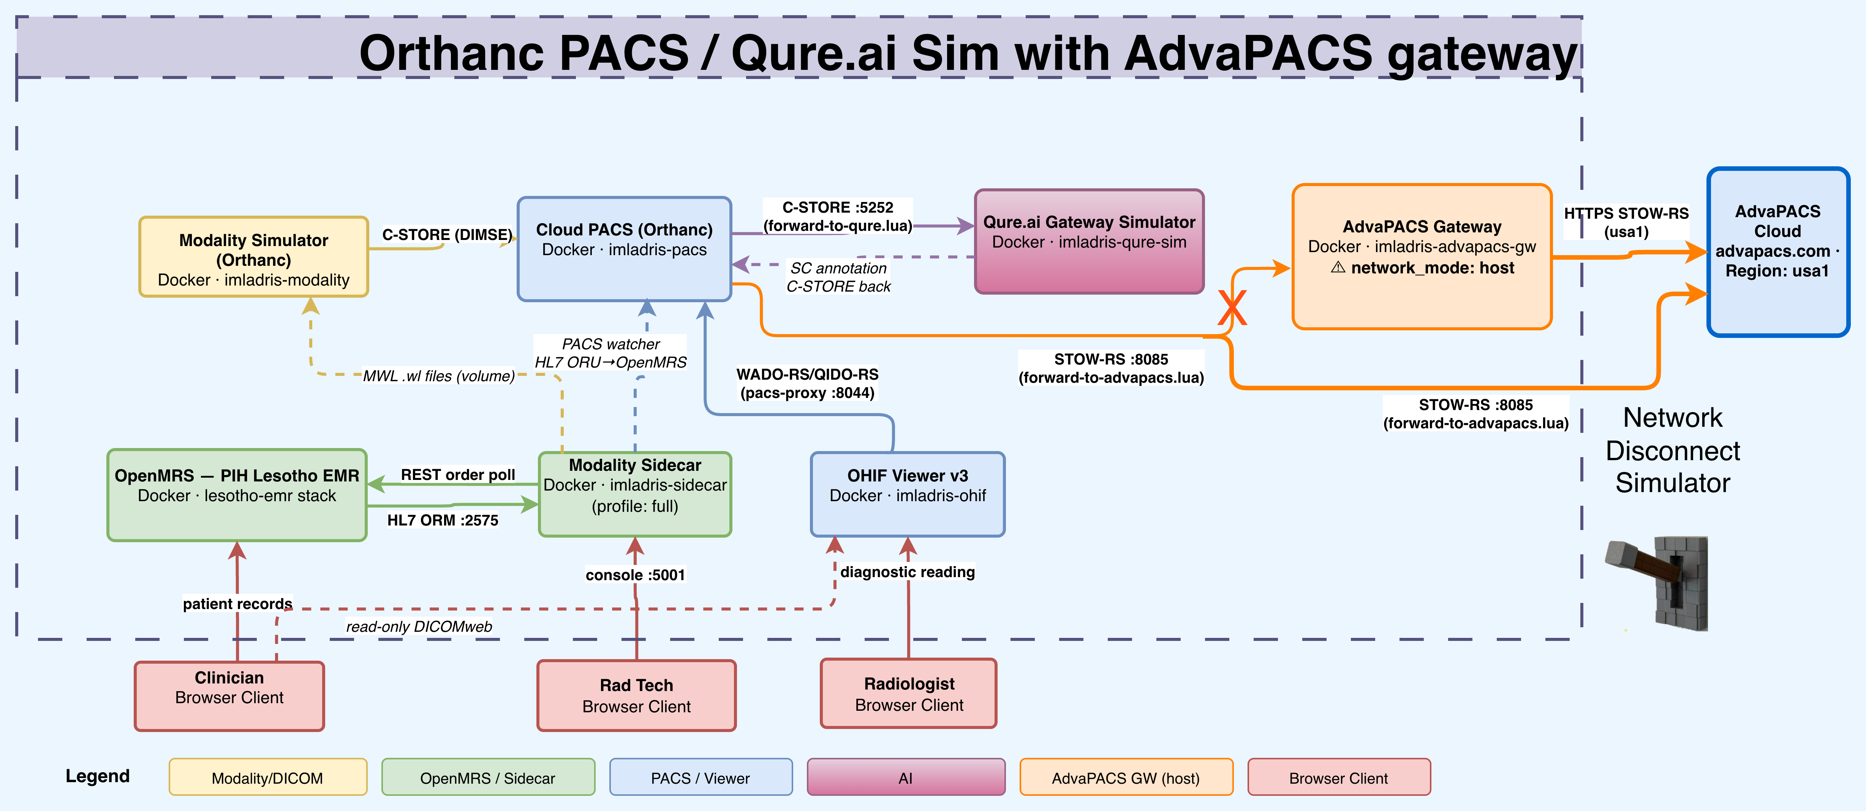
OP-QS Orthanc PACS / Qure.ai Sim with AdvaPACS gateway

Slide 9
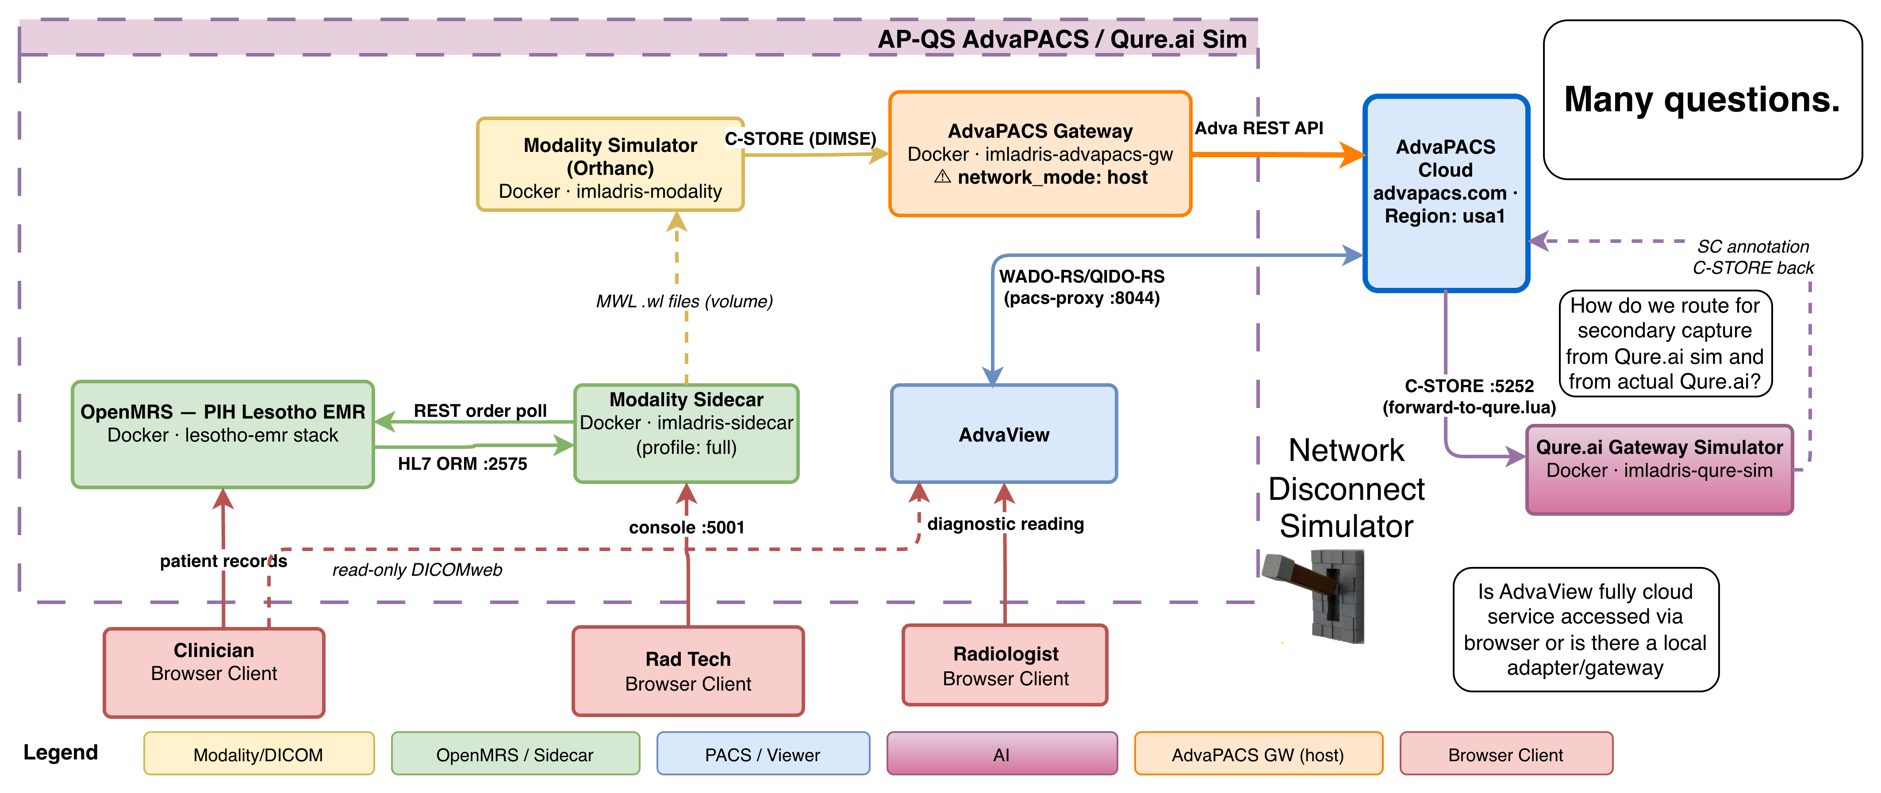
AP-QS AdvaPACS / Qure.ai Sim

Slide 10
Next steps?
Set up HL7 progress / status reporting back to OpenMRS.
Support study reporting workflows.
Explore full set of Botsabelo EMR/PACS workflows and support in the lab.
More.
Opt in for notifications on the Imladris Lab and Bophelong Health Network (BHN) News page: https://pihemr.atlassian.net/wiki/x/AQDLBgE

Slide 11
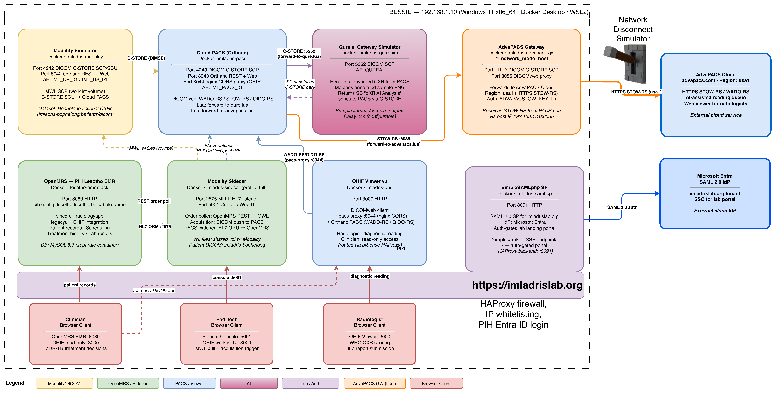
AdvaPACS + Qure Sim (AP-QS)

